Slide 1
Resilience and Self-Care: What We’re Learning During COVID-19
Patrick Slifka, MSW, LCSW
jpatrick.slifka@ncgcare.com
804-652-8266

Slide 2
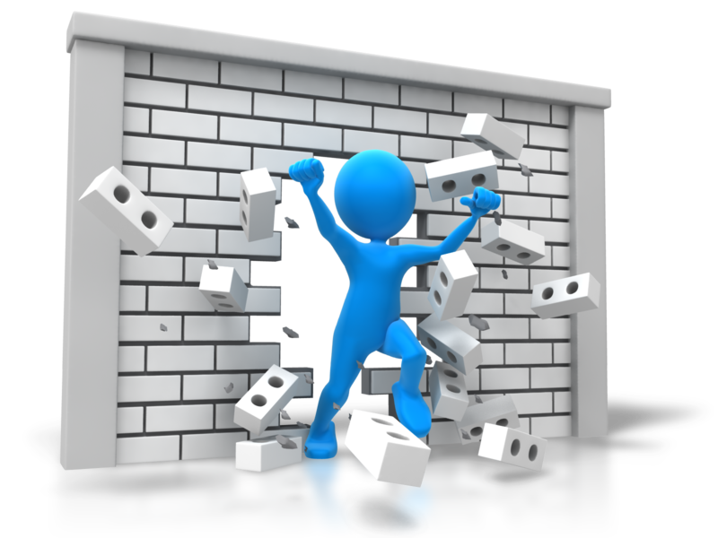
Reminder: Self-Care First
Take action against your own stress & anxiety
Pace yourself
Breathe
Maintain good health habits
Exercise, exercise, exercise
Connect
Take breaks
Promote teamwork
Maintain structure and routines at home
Focus on flexibility

Slide 3
Check this out.
The good ‘ole “Cold Water Vagus Nerve Reset Trick” or the “Mammalian Diving Response”
Picture can also remind us of not taking on too much (“drinking from a firehose”)!

Slide 4
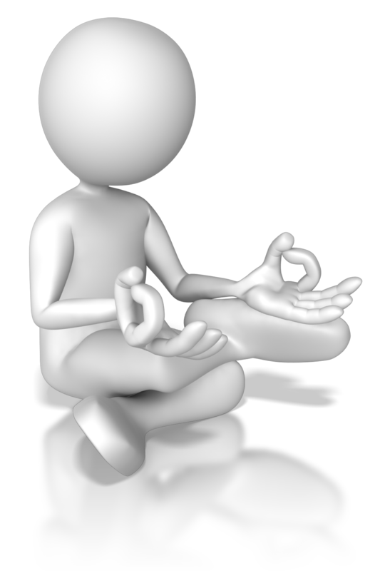
Breathe
4-7-8 Technique
(Dr. Andrew Weil)
Place the tip of your tongue against the ridge of tissue just behind your upper front teeth, and keep it there through the entire exercise. You will be exhaling through your mouth around your tongue; try pursing your lips slightly if this seems awkward.
Exhale completely through your mouth, making a whoosh sound.
Close your mouth and inhale quietly through your nose to a mental count of four.
Hold your breath for a count of seven.
Exhale completely through your mouth, making a whoosh sound to a count of eight. This is one breath.
Now inhale again and repeat the cycle three more times for a total of four breaths.

Slide 5
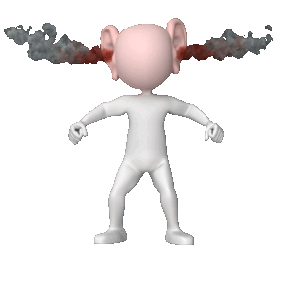
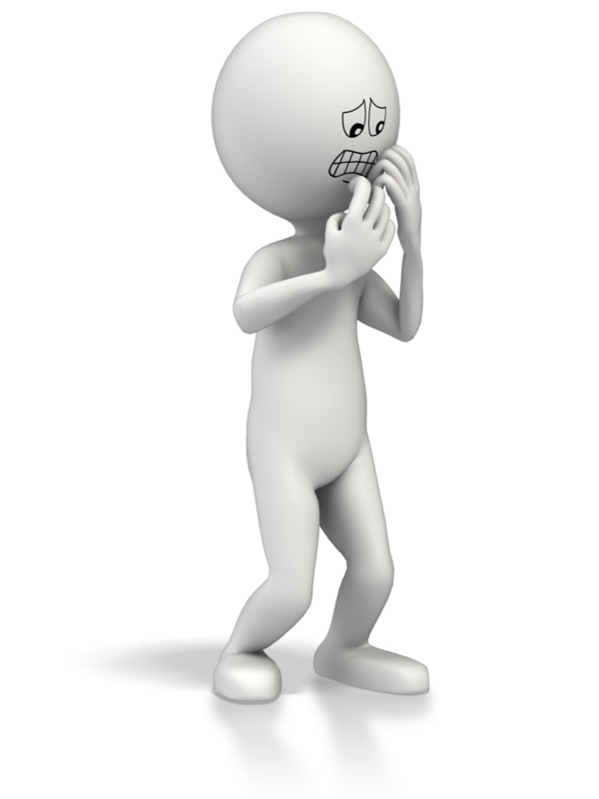
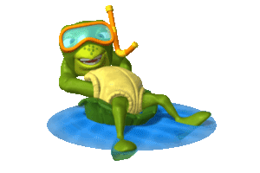
Key Point: Relational Contagion (Dr. Bruce Perry; bdperry.com)
Co-dysregulation Reactive client and overwhelmed helper
Co-regulation Reactive client and well-regulated helper
Regulate
Relate
Reason

Slide 6
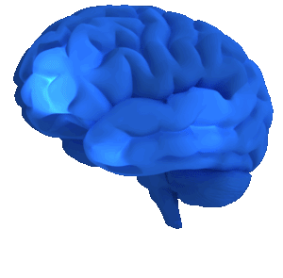
Trauma and Neurobiology

Slide 7
Embedded PowerPoint Video
Autonomic Nervous System: Our Balance System
Regulates body processes
Works automatically (autonomously), without a person’s conscious effort.
When out of balance, adaptions or mitigations occur in body parts and/or processes.
Behavioral symptoms result from the over-use of the threat/stress response system.
By PresenterMedia.com

Slide 8
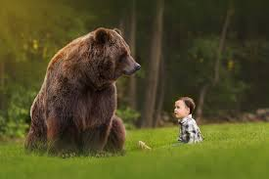
If You Met a Bear.

Slide 9
Symptoms of Activation Within the Balance System
Sympathetic/Hot:
Accelerate the heart rate
Constrict blood vessels
Raise blood pressure, muscle tension, physical sensation amplification.
Inhibition of insulin production to maximize fuel availability
Cold hands and feet
Headaches
ParaSympathetic/Cool:
Promote digestion
Intestinal motility
Fuel storage (increases insulin activity)
Resistance to infection
Circulation to non-vital organs
Release endorphins
Decreases heart rate, blood pressure and body temperature

Slide 10
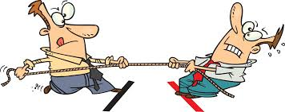
When out of balance… these systems play tug-of-war!
What happens when the sympathetic controls?
Notes:
Many organs are controlled primarily by either the sympathetic or the parasympathetic. Sometimes the two have opposite effects on the same organ.
For example, the sympathetic increases blood pressure, and the parasympathetic decreases it.
Overall, the two divisions are supposed to work together to ensure that the body responds appropriately to different situations.

Slide 11
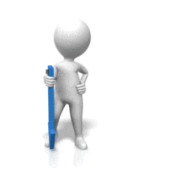
What will you see when the brain is bathing in the cocktail?
Fight, flight, or freeze!
Low or no self-awareness
Low or no capacity to self-evaluate
Low or no ability to self-regulate
Low or no facility to establish goals and act consistently to obtain them
Poor self-image
Likely reacting to rather than being intentional
Self-centered and Narcissistic is correct behavior
Absolutely correct behavior!!!!

Slide 14
In Our Current Situation…?
We don’t need much activation in order to trigger movement into the Sympathetic System Dominance

Slide 16
Resilience
“Fall Down Seven, Get Up Eight” – Japanese Proverb

Slide 17
Resilience: Defined
“Resiliency is the capability of individuals to cope successfully in the face of significant change, adversity or risk. The capacity changes over time and is enhanced by protective factors in the individual and in the environment.” (Steward, et al., 1991)
“Resilience is a term used to describe an individual's ability to withstand adversity and hardship - often, but not always including exposure to trauma - and move forward with life tasks and quality of life, despite the negative circumstances.” (Coatsworth and Duncan, 2003).

Slide 18
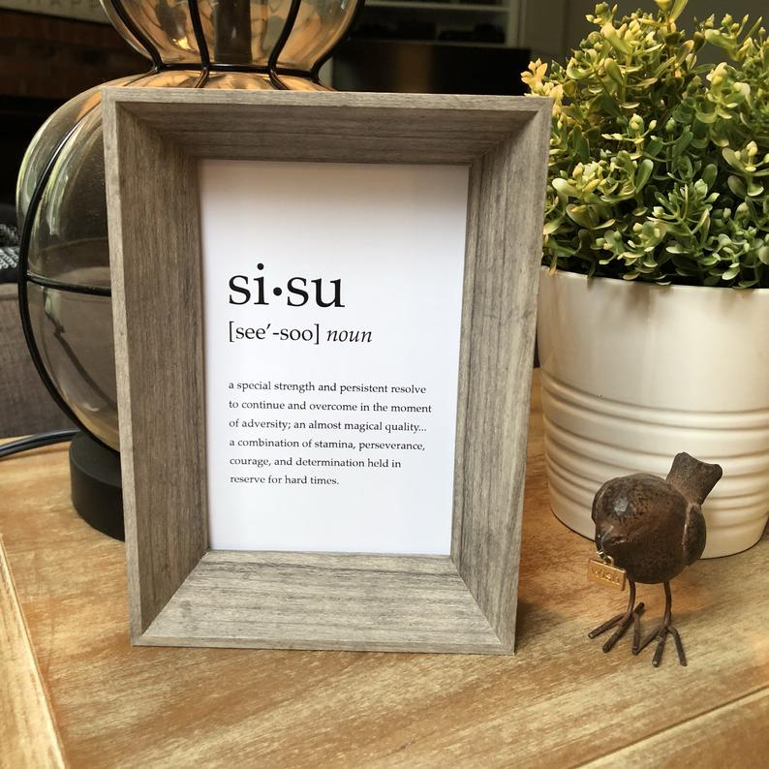
Resilience
Ability to bounce back when faced with stress or pressure ‘
Goal?
Post-traumatic growth?

Slide 19
Deliberate Resilience
The process of adapting well in the face of adversity, trauma, tragedy, threats or significant source of stress.
The capacity for resilience is inherent in all people. It’s neither lucky nor passive. It takes deliberate effort.

Slide 20
Resilience Attitude

Slide 21
Categories of Resilience
Individual (personal characteristics/skills)
Community (social supports/sense of connection)
Existential (sense of meaning and purpose)
Apply to both professionals (us) and organizations.

Slide 22
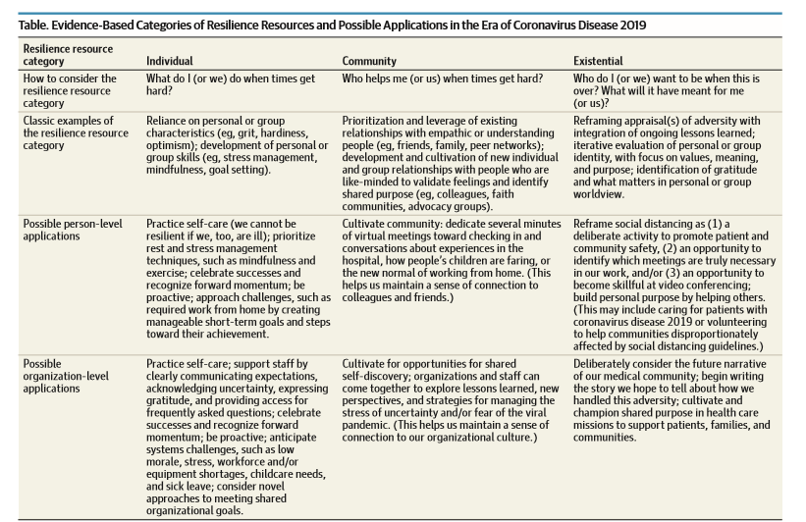

Slide 23
Professional Resilience: Practical Strategies for Us as Professionals
Meet your basic needs
Take breaks
Stay connected
Respect differences
Stay updated
Perform self check-ins
Honor your service

Slide 24
Professional Resilience: Practical Strategies for us as Leaders
Value your staff
Communicate best practices
Monitor and promote well-being
Provide supportive and blame-free culture
Enable cooperation and collaboration
Provide a central access point for updates and tools

Slide 25
Let’s be Proactive
Harness our resources (individual, community, existential) to thrive, not merely survive
Imagine our future narrative. When we look back on our story, what will we be able to say?

Slide 26
Breakouts
Imagine we’re looking back on this era. To be able to say that we adapted well, discuss and record the following:
Who do we want to be when this is over? What’s the story you want to tell about how we handled this adversity? What did you do? Who helped you?

Slide 27
Promoting Resilience in our clients
How Do We Help?

Slide 28
Understanding Context
Individual
Family
Social/Community
Culture
Other social determinants of health
Consider basic needs as part of this context

Slide 29
MI: 4 Processes
Engagement
Focusing
Evoking
Planning

Slide 30
5 Intervention Principles that Support Resiliency (Hobfoll, et al., 2007)
Empirically-supported intervention principles (early to mid-term stages of mass trauma)
Promote a sense of safety
Promote calming
Promote self and collective efficacy
Promote connectedness
Promote hope

Slide 31
Autonomy

Slide 32
Mastery

Slide 33
Purpose

Slide 34
Discussion
Share strategies and suggestions re: your experience with “what works” in any or all of the following in your work with clients:
Regulation
Relationship
Reasoning

Slide 35
National Counseling Group: an ncgCARE Partner
We are committed to improving lives through a service model that we proudly call CARE. CARE allows individuals, parents, families, and professionals to achieve their goals and experience long-lasting and meaningful results. We promise to provide CARE through...
Active communication
Timely access
Individualized care
Dependable results
Unwavering integrity

Slide 36
Resources
https://www.healthline.com/nutrition/16-ways-relieve-stress-anxiety#section1
https://www.helpguide.org/articles/anxiety/coronavirus-anxiety.htm
https://adaa.org/tips-manage-anxiety-and-stress
https://mentalhealthchannel.tv/episode/youre-wired-for-anxiety-and-youre-wired-to-handle-it
https://compassionresiliencetoolkit.org/staying-resilient-during-covid-19
https://www.neurosequential.com/covid-19-resources
https://www.drweil.com/videos-features/videos/breathing-exercises-4-7-8-breath/

Slide 37
References/Resources
Rosenberg, A. Cultivating deliberate resilience during the coronavirus disease 2019 pandemic. Published April 14, 2020. Accessed May 5, 2020. https://jamanetwork.com/journals/jamapediatrics/fullarticle/2764729
National Academy of Medicine. Employees: How to cope with job stress and build resilience during the covid-19 pandemic. Accessed May 11, 2020. https://nam.edu/initiatives/clinician-resilience-and-well-being/clinician-well-being-strategies-during-covid-19/
Sandberg S, Grant, A. (2017). Option B: Facing adversity, building resilience, and finding joy. New York: Alfred A. Knopf
Zolli, A. (2012). Resilience: Why things bounce back. New York: Simon & Schuster.
Univ. of PA. Resilience Profile and Personalized Recommendations https://covid19resilience.org/

Slide 38
References/Resources
Coatsworth, J.D. and Duncan, L. (2003). Fostering resilience: A strengths-based approach to mental health - a CASSP discussion paper. Harrisburg: Pennsylvania CASSP Training and Technical Assistance Institute.
Duckworth, A. (2016). Grit: The power of passion and perseverance. New York: Scribner.
Hobfoll SE, Watson P, Bell CC, et al. Five essential elements of immediate and mid-term mass trauma intervention: empirical evidence. Psychiatry. 2007;70(4):283‐369. doi:10.1521/psyc.2007.70.4.283
Perry, B.D, & Szalavitz, M. (2006). The boy who was raised as a dog: And other stories…New York. Basic Books.
Pink, D. H. (2009). Drive: The surprising truth about what motivates us. New York, NY. Riverhead Books.
Sandberg S, Grant, A. (2017). Option B: Facing adversity, building resilience, and finding joy. New York: Alfred A. Knopf.
Zolli, A. (2012). Resilience: Why things bounce back. New York: Simon & Schuster.

